Slide 1
by HERBER

Slide 2
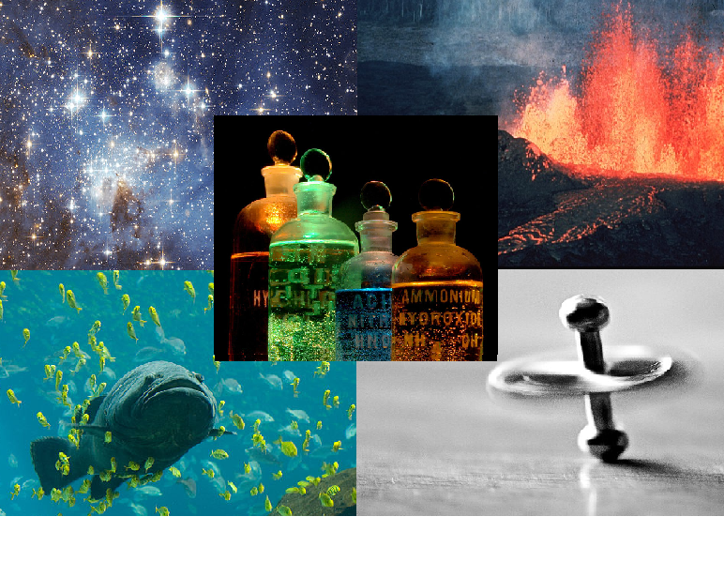
science

Slide 3
maths

Slide 4
English

Slide 5
French

Slide 6
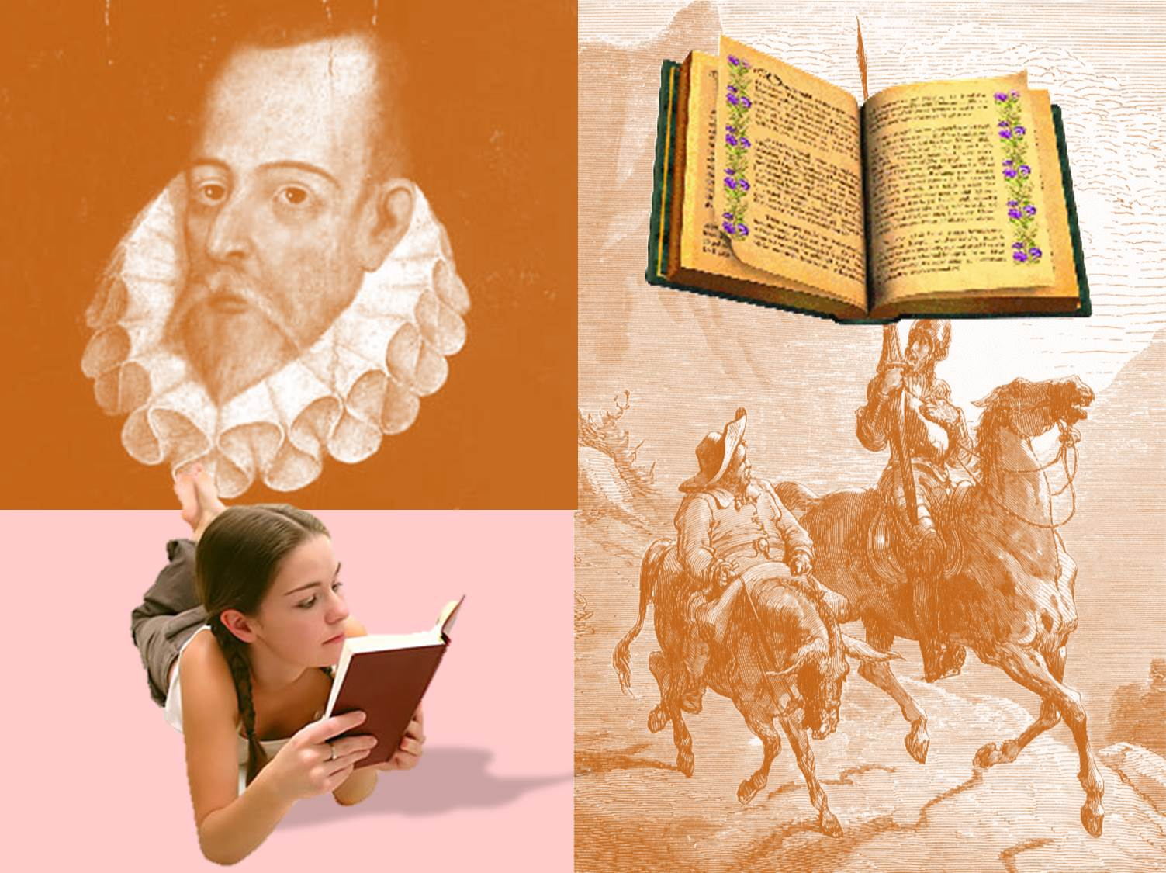
literature

Slide 7
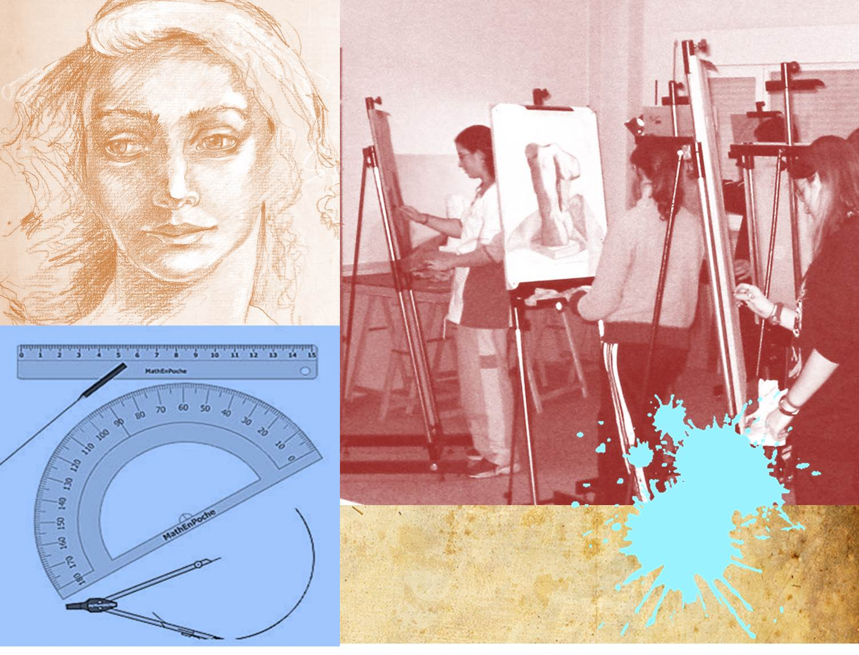
art

Slide 8
Physical Education

Slide 9
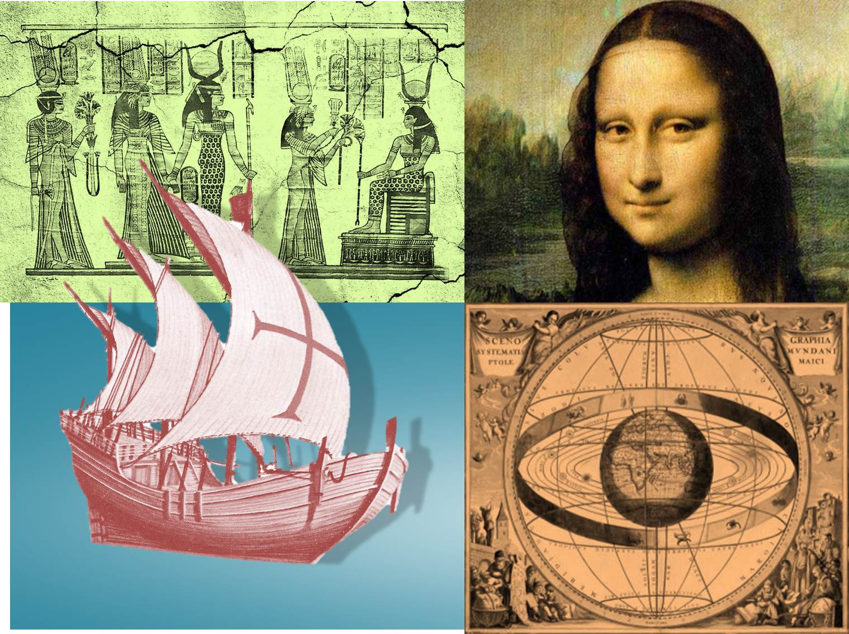
history

Slide 10
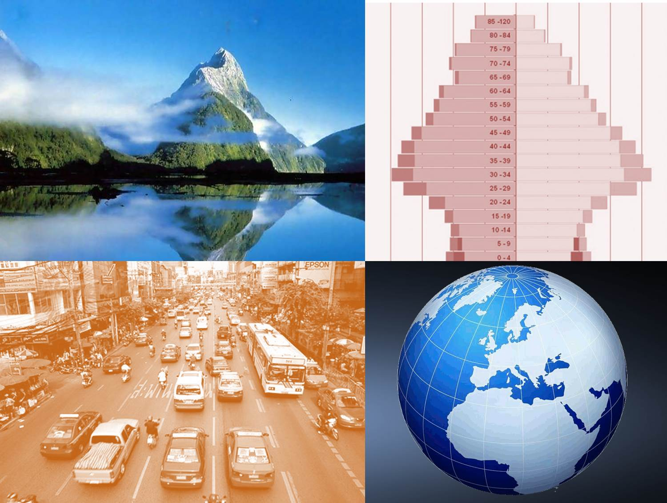
geography

Slide 11
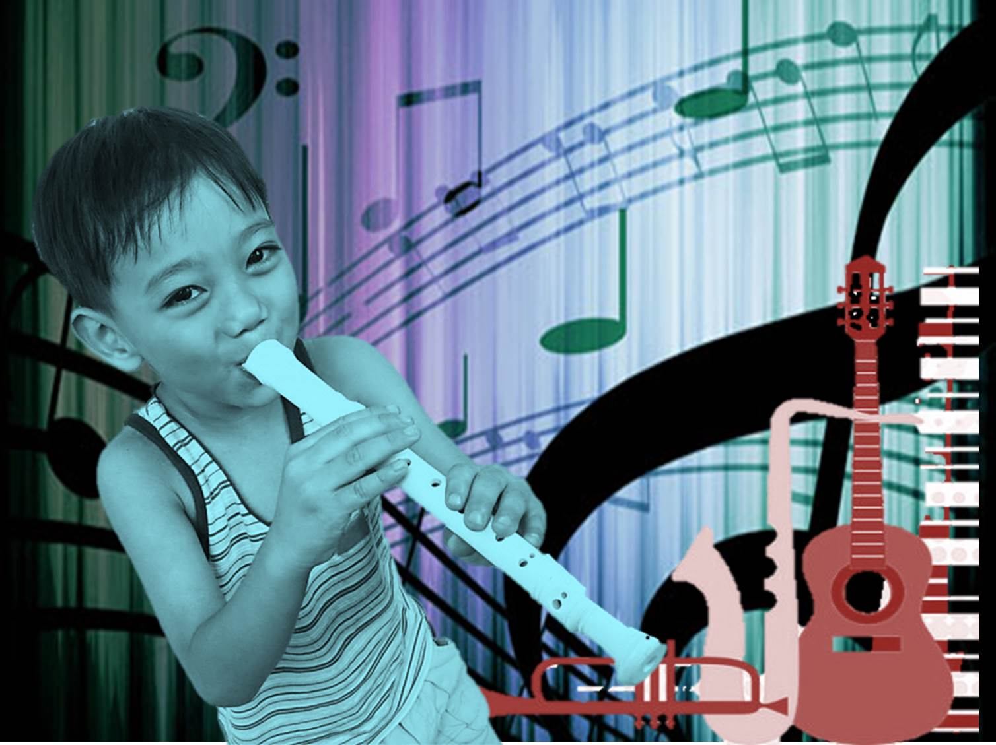
music

Slide 12
computer technology

Slide 13
technology

Slide 14
What’s your favourite subject?
Why?

